Slide 1

CSYE 7200 Project -
NCBI Taxonomy Search Engine
Team Member: Zhilong Hou, Li Ma
Professor: Robin Hillyard

Slide 2
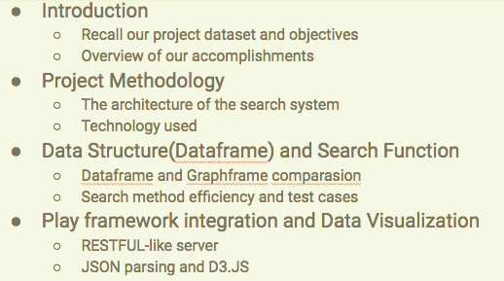
Agenda

Slide 3
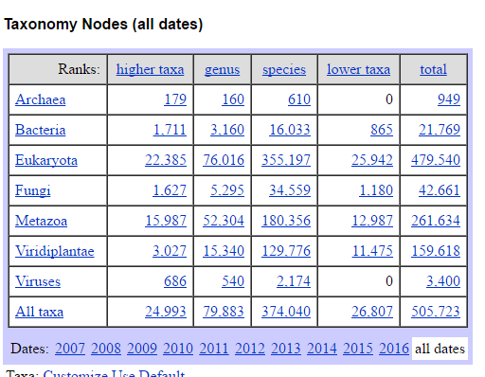
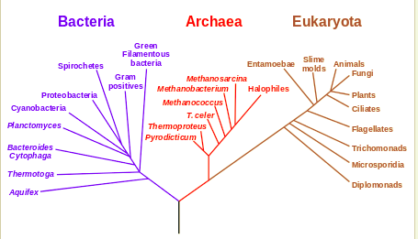
Data Description
ftp://ftp.ncbi.nih.gov/pub/taxonomy
NCBI Taxonomy Database: A curated set of names and classifications for all of the organisms that are represented in GenBank.:
Names.dmp(133.4MB)
Nodes.dmp(104MB)
Number of Node: 1,528,461

Slide 4
Project Goals versus Accomplishments
Goals | Accomplishments
Implement multiple search method on NCBI Taxonomy database | Implemented 3 search method on 2 different data structure
Implement Spark and build dataframe with GraphX | Built the dataframe with “dataframe” & “graphframe” instead, with better traversal method
Create web user interface, visualize the data by using D3.js | Created web UI for user to search for 3 different requirement and draw the tree with D3.js
Build search index for querying relationship of nodes | Created service function like getSiblings(), isSubtree(), getPathToRoot(), getChildNodes()

Slide 5
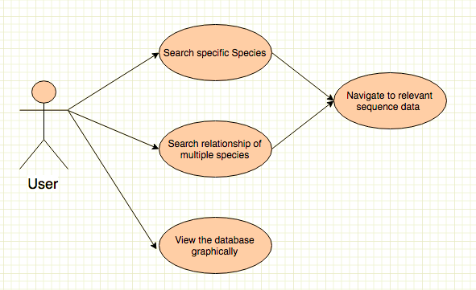
Use Case

Slide 6
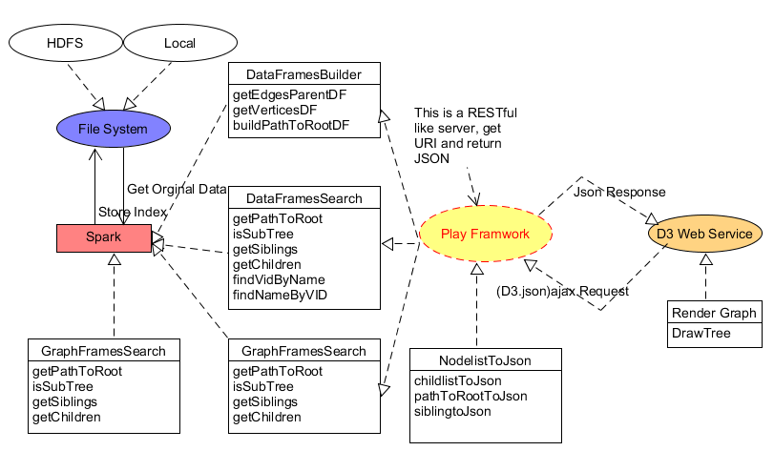
Architecture

Slide 7
Data Builder

Slide 8
Data Structures
1. DataFrame
A DataFrame is a Dataset organized into named columns. It is conceptually equivalent to a table in a relational database. It's a part of Spark SQL.
2. GraphFrame
GraphFrames is a package for Apache Spark which provides DataFrame-based Graphs. It extended functionality includes motif finding, which could traversal itself.

Slide 9
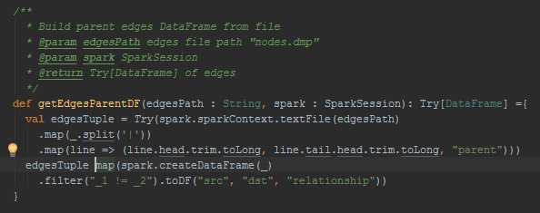
Data Builder
1. getEdgesParentDF
2. getVerticesDF
3. buildPathToRootDF
src | dst | relationship

Slide 10
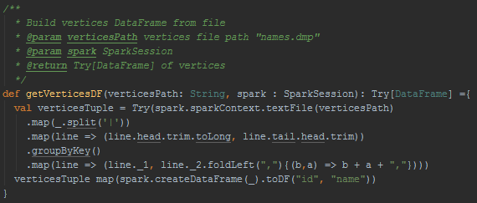
Data Builder
1. getEdgesParentDF
2. getVerticesDF
3. buildPathToRootDF
id | parentPathToRoot

Slide 11
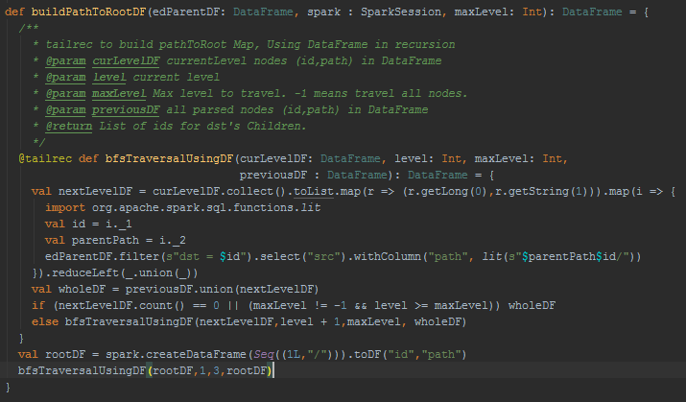
Data Builder
1. getEdgesParentDF
2. getVerticesDF
3. buildPathToRootDF
id | parentPathToRoot

Slide 12
Build Search Methods

Slide 13
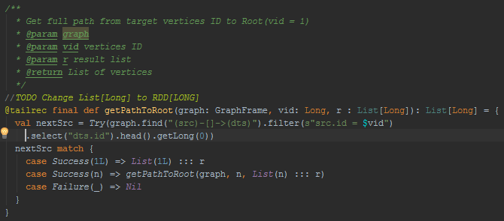
GraphFrame Search
1. getPathToRoot
2. isSubTree
3. getSiblings
4. getChildren
Motif finding: simple Domain-Specific Language (DSL)

Slide 14
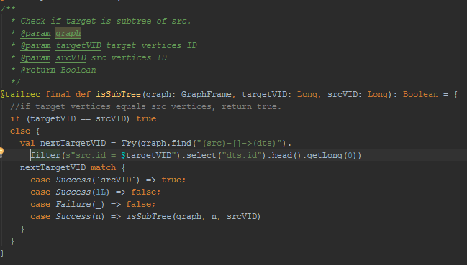
GraphFrame Search
1. getPathToRoot
2. isSubTree
3. getSiblings
4. getChildren
Motif finding: simple Domain-Specific Language (DSL)

Slide 15
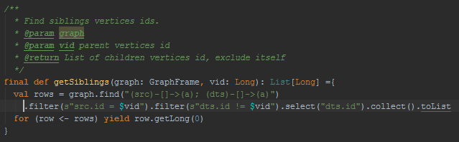
GraphFrame Search
1. getPathToRoot
2. isSubTree
3. getSiblings
4. getChildren
Motif finding: simple Domain-Specific Language (DSL)

Slide 16
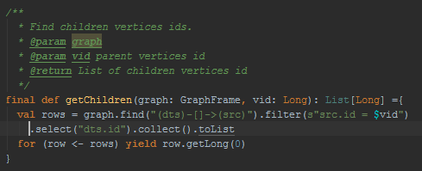
GraphFrame Search
1. getPathToRoot
2. isSubTree
3. getSiblings
4. getChildren
Motif finding: simple Domain-Specific Language (DSL)

Slide 17
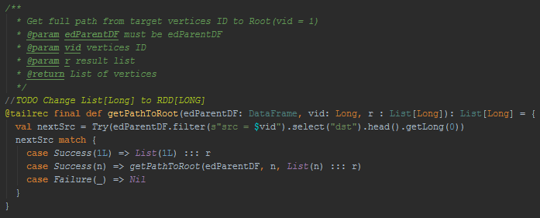
DataFrame Search
1. getPathToRoot
2. isSubTree
3. getSiblings
4. getChildren
5. findVidByName
6. findNameByVID
src | dst | relationship

Slide 18
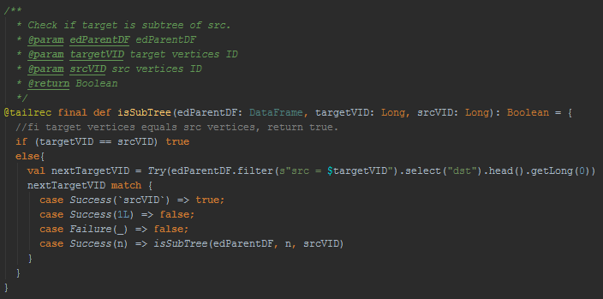
DataFrame Search
1. getPathToRoot
2. isSubTree
3. getSiblings
4. getChildren
5. findVidByName
6. findNameByVID
src | dst | relationship

Slide 19
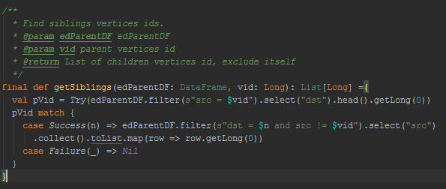
DataFrame Search
1. getPathToRoot
2. isSubTree
3. getSiblings
4. getChildren
5. findVidByName
6. findNameByVID
src | dst | relationship

Slide 20
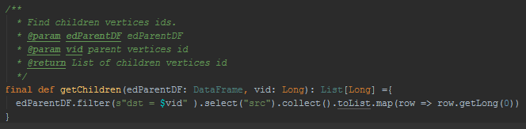
DataFrame Search
1. getPathToRoot
2. isSubTree
3. getSiblings
4. getChildren
5. findVidByName
6. findNameByVID
src | dst | relationship

Slide 21
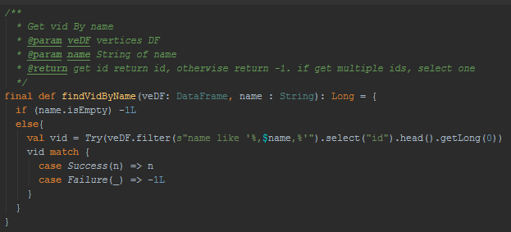
DataFrame Search
1. getPathToRoot
2. isSubTree
3. getSiblings
4. getChildren
5. findVidByName
6. findNameByVID
src | dst | relationship

Slide 22
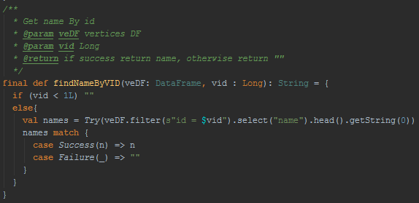
DataFrame Search
1. getPathToRoot
2. isSubTree
3. getSiblings
4. getChildren
5. findVidByName
6. findNameByVID
src | dst | relationship

Slide 23
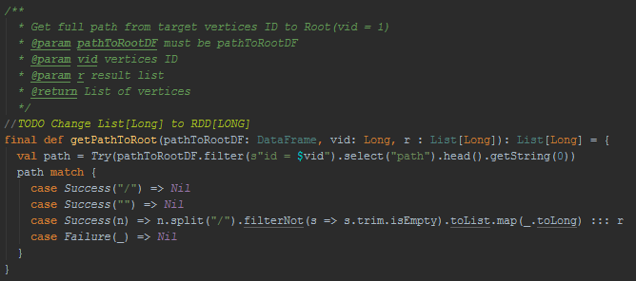
DataFrame Indexing
Search
1. getPathToRoot
2. isSubTree
3. getSiblings
4. getChildren
id | parentPathToRoot

Slide 24
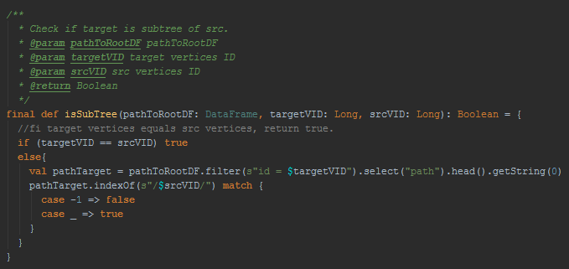
DataFrame Indexing
Search
1. getPathToRoot
2. isSubTree
3. getSiblings
4. getChildren
id | parentPathToRoot

Slide 25
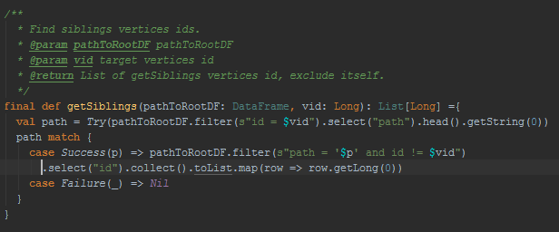
DataFrame Indexing
Search
1. getPathToRoot
2. isSubTree
3. getSiblings
4. getChildren
id | parentPathToRoot

Slide 26
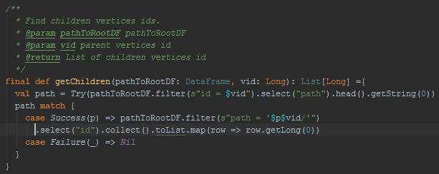
DataFrame Indexing
Search
1. getPathToRoot
2. isSubTree
3. getSiblings
4. getChildren
id | parentPathToRoot

Slide 27
Testing

Slide 28
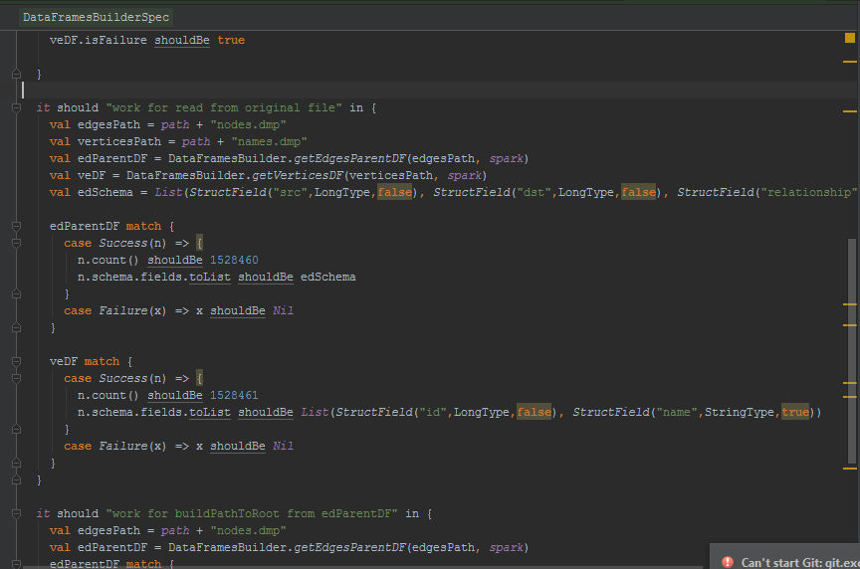
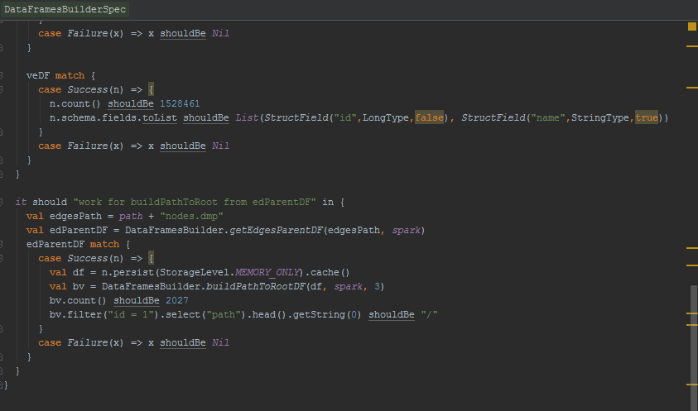

Data Builder Testing

Slide 29
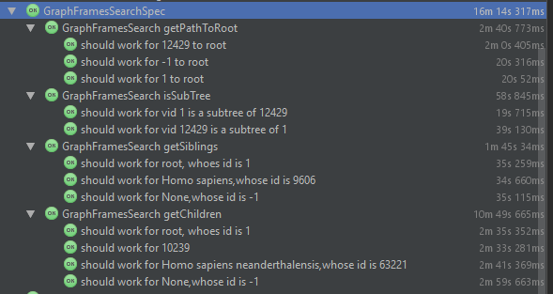
GraphFrame Search Testing

Slide 30
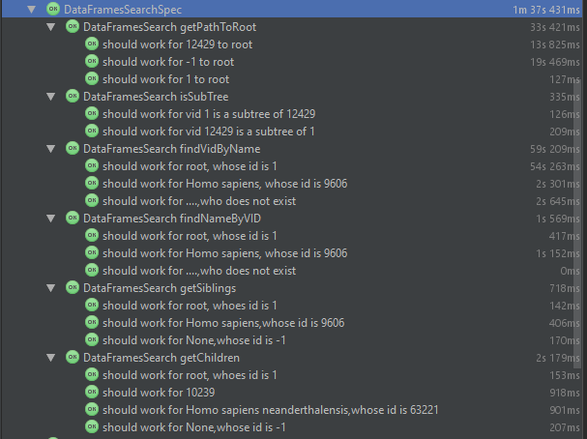
DataFrame Search Testing

Slide 31
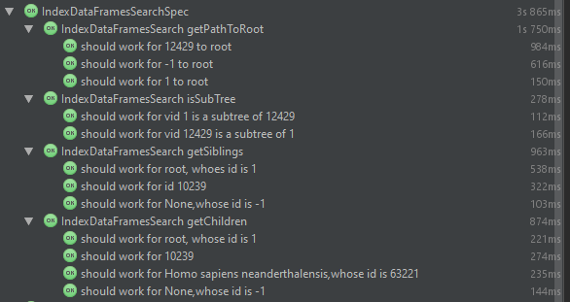
DataFrame Indexing Search Testing

Slide 32
DataFrame Indexing Search Testing

Slide 33
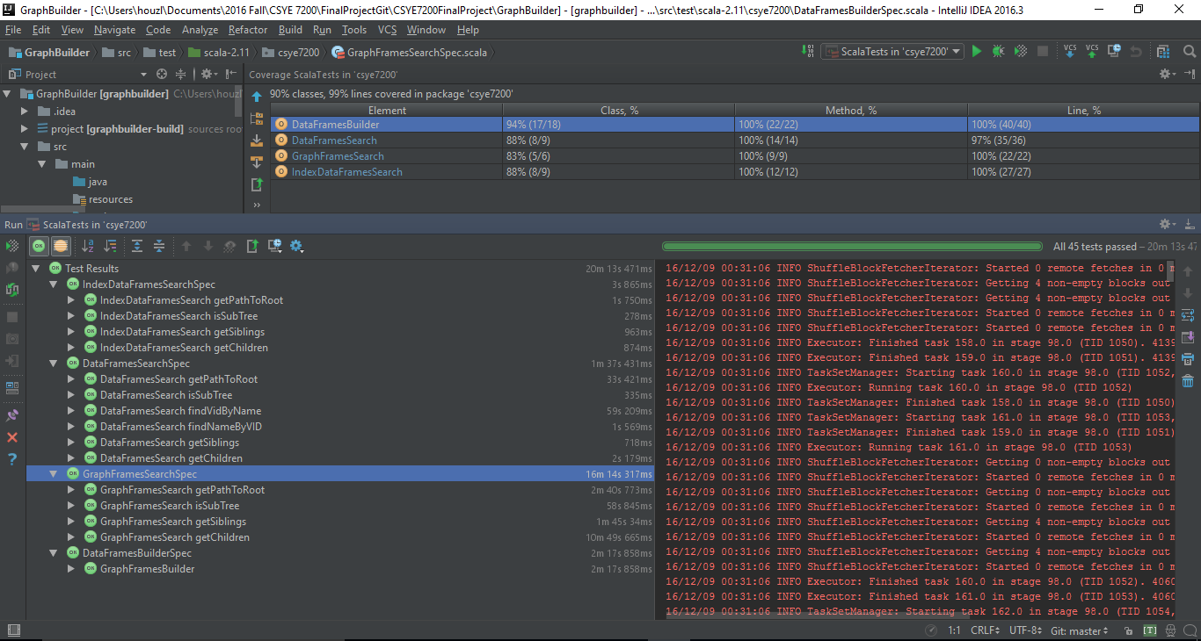
Fully tested

Slide 34
Play Framework and D3.JS

Slide 35

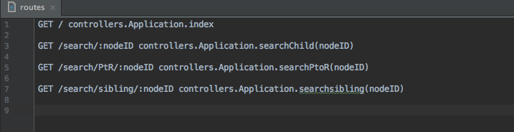
Play Framework and D3.JS
An html Page runs on any server
User Input
localhost:8000/search/index.html
HttpRequest Get(D3.JSON)
An ajax request provided by D3
D3.JSON(localhost:9000/search/${userInput})
Controller in Play handles the request
Call search function and parse to JSON
Response JSON to client
play.api.libs.json._
Render with D3

Slide 36
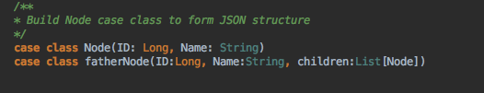

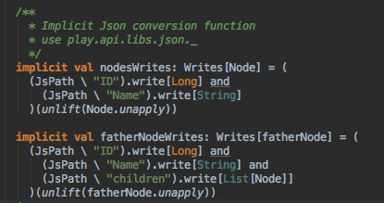
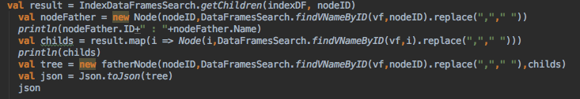
JSON Parsing
Controller Call:

Slide 37
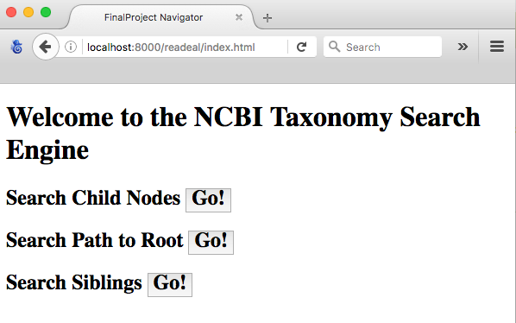
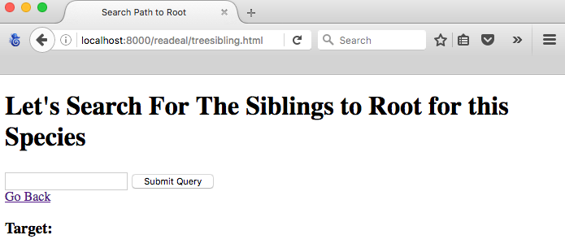
Web Interface

Slide 38
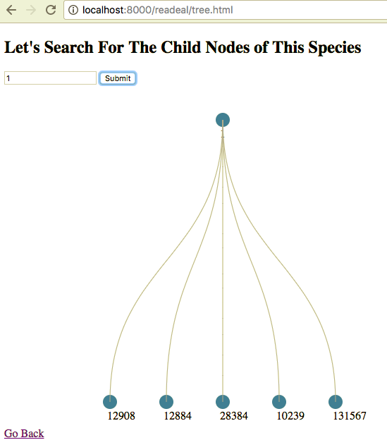
Web Interface - Get Child Nodes
{"ID":1,
"Name":" all root ",
"children":
[{"ID":12908,"Name":" unclassified unclassified unclassified sequences unclassified. "},
{"ID":12884,"Name":" Viroid Viroids viroids "},
{"ID":28384,"Name":" other sequences other sequences "},
{"ID":10239,"Name":" Vira Viridae Viruses viruses "},
{"ID":131567,"Name":" biota cellular organisms "}
]
}

Slide 39
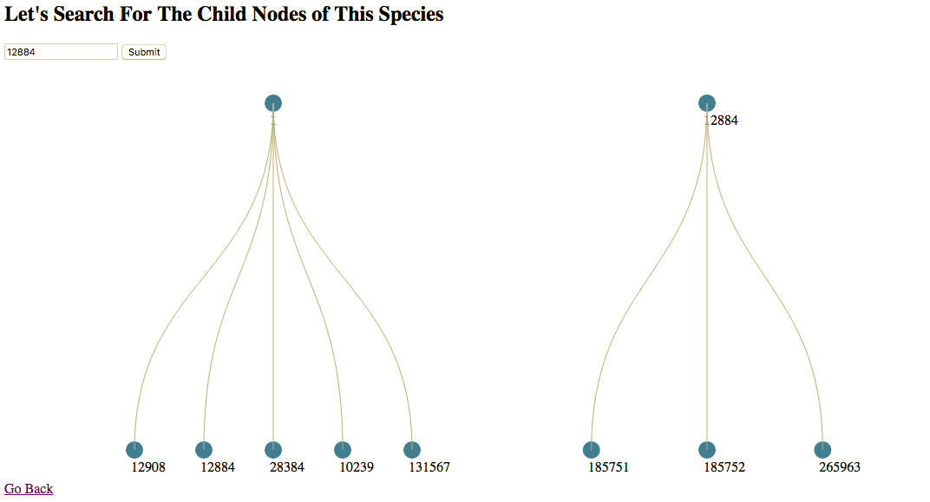
Web Interface - Get Child Nodes

Slide 40
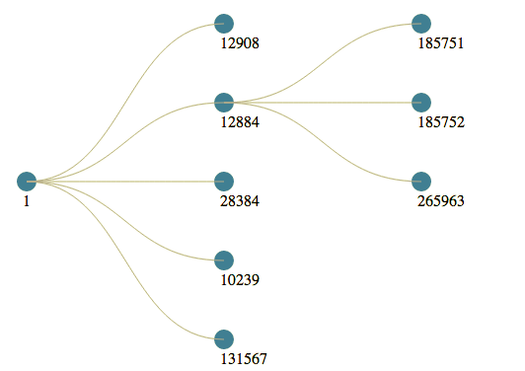
Web Interface - Get Child Nodes(nested)

Slide 41
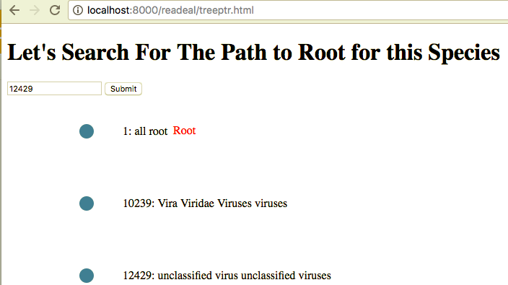
Web Interface - Get Path To Root
[
{
"ID":1,
"Name":" all root "
},
{
"ID":10239,
"Name":" Vira Viridae Viruses viruses "
},
{
"ID":12429,
"Name":" unclassified virus unclassified viruses "
}
]

Slide 42
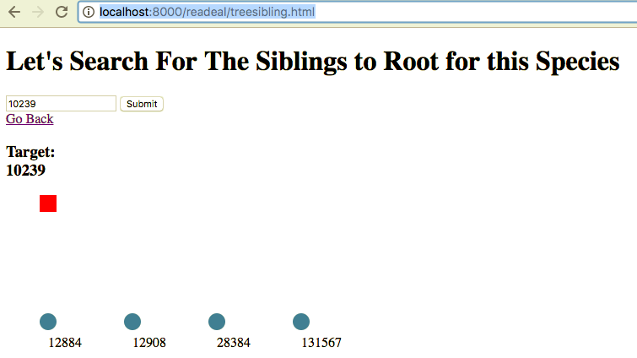
Web Interface - Get Siblings
[
{
"ID":12884,
"Name":" Viroid Viroids viroids "
},
{
"ID":12908,
"Name":" unclassified unclassified unclassified sequences unclassified. "
},
{
"ID":28384,
"Name":" other sequences other sequences "
},
{
"ID":131567,
"Name":" biota cellular organisms "
}
]

Slide 43
Acceptance Criteria
Have at least 2 search algorithms for sub-tree query. ✓
For querying the data, it should be quick for user to use. User should get the result in 2 secs. ✓
The relationship of the target node should be visualized clearly and accurately for its parent node, sibling nodes and children nodes from 1,528,461 nodes. ✓

Slide 44
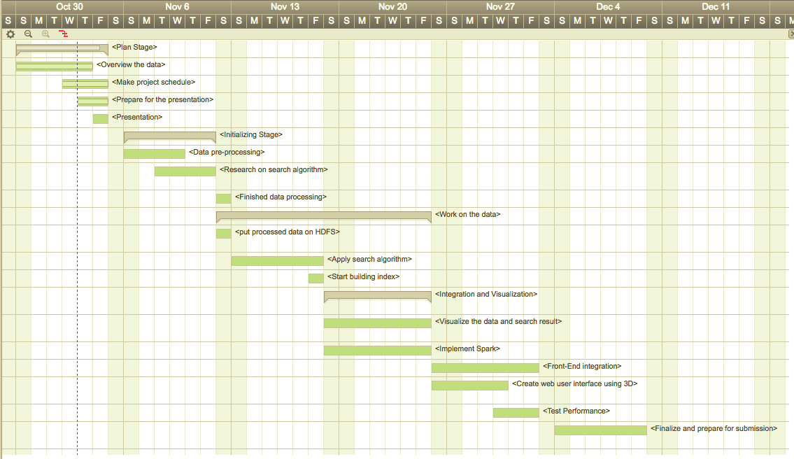
Milestones- Gantt Chart

Slide 45
Architecture

Slide 46
Thank you !

